Slide 1
Campus Traffic Monitoring
Udayin Biswas, Kapil Kumar and Mahdihusain
Mentor: Mr.Anoop G Prabhu

Slide 2

OBJECTIVE
To send warning to the people who violate the speed limit of 30 km/hr inside campus.
Send SMS to the residents of IIT who violate the speed limit.
Display the car’s license number on LED display board for non-residents of IIT who violate the speed limit.

Slide 3
BACKGROUND
Creating general awareness about speed control and responsible driving.
Safer roads for pedestrians and less probability for accidents inside IIT campus.

Slide 4
METHODOLOGY
Camera records a video of the vehicle and sends it to LMS (Image Processing Unit).
LMS detects the vehicle number and speed and adds it to database.

Slide 5
METHODOLOGY
A script queries the database and finds out whether the violator is resident or non-resident of IIT.
For residents, a SMS is sent to the vehicle owner’s phone number using Arduino GSM Shield.
For non-residents, when that vehicle exits through any gate, the car number and speed of vehicle is displayed on LED board to warn the driver.

Slide 6
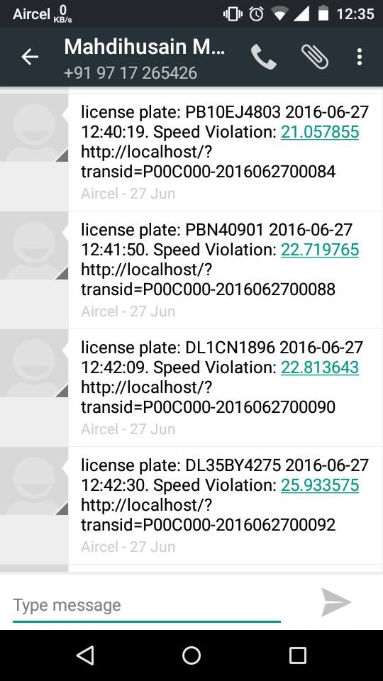
SMS FORMAT

Slide 7
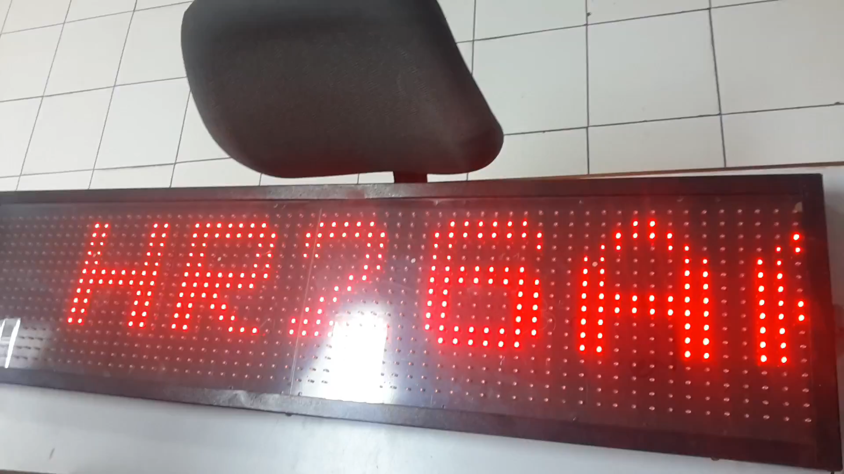
LED DISPLAY FORMAT

Slide 8
DELIVERABLES
Project Deliverables : SMS sending to residential violators and functional LED board for non-residential violators.
Achieved Deliverables: automated SMS sending achieved, Successful in displaying message on LED board. Once we get access to IIT campus database, we will automate the display.

Slide 9
Major Learning
Learnt and improved skills in Python, C++ and got exposure to softwares like Arduino IDE, Hyperterminal, Realterm in the process.
Learnt about serial communication.
Project gave emphasis on a smart campus.
Success comes only after failing a lot of times but never giving up.

Slide 10
THANK YOU

